Slide 1
Spark
Fast, Interactive, Language-Integrated Cluster Computing

Slide 2
What is Big Data?
No single definition; here is from Wikipedia:
Big data is the term for a collection of data sets so large and complex that it becomes difficult to process using on-hand database management tools or traditional data processing applications.
The challenges include capture, curation, storage, search, sharing, transfer, analysis, and visualization.
The trend to larger data sets is due to the additional information derivable from analysis of a single large set of related data, as compared to separate smaller sets with the same total amount of data, allowing correlations to be found to "spot business trends, determine quality of research, prevent diseases, link legal citations, combat crime, and determine real-time roadway traffic conditions.”

Slide 3
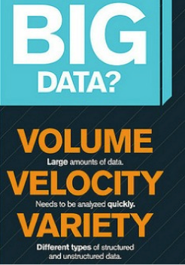

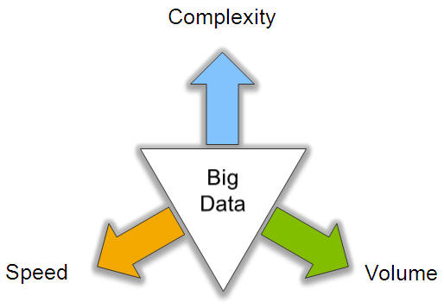
Big Data: 3V’s

Slide 4
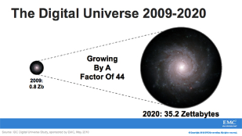
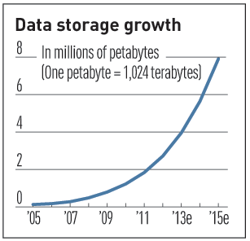

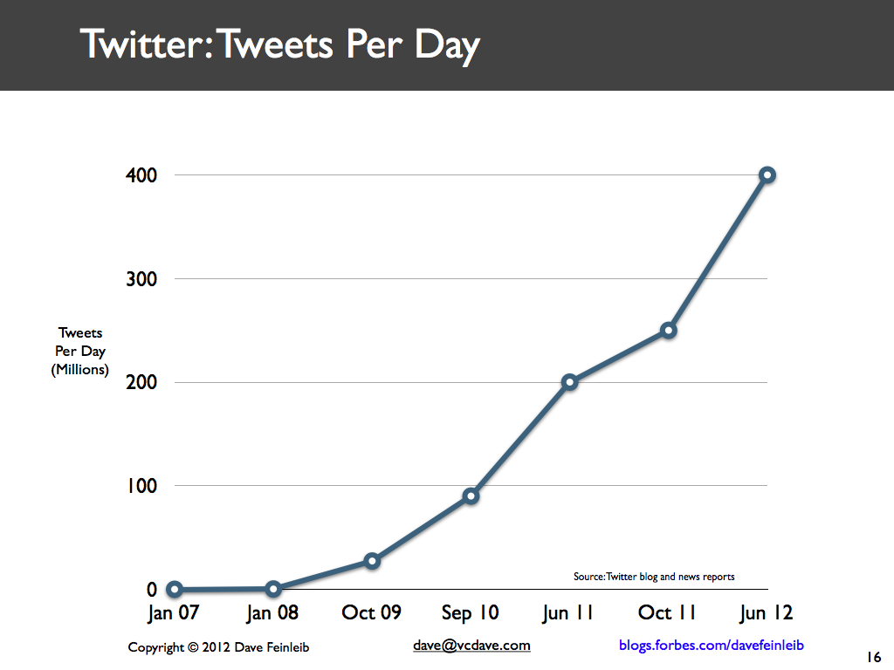
Volume (Scale)
Data Volume
44x increase from 2009 2020
From 0.8 zettabytes to 35zb
Data volume is increasing exponentially
Exponential increase in collected/generated data

Slide 5





4.6 billion camera phones world wide
30 billion RFID tags today (1.3B in 2005)
12+ TBs of tweet data every day
100s of millions of GPS enabled devices sold annually
? TBs of data every day
25+ TBs of log data every day
2+ billion people on the Web by end 2011
76 million smart meters in 2009… 200M by 2014

Slide 6
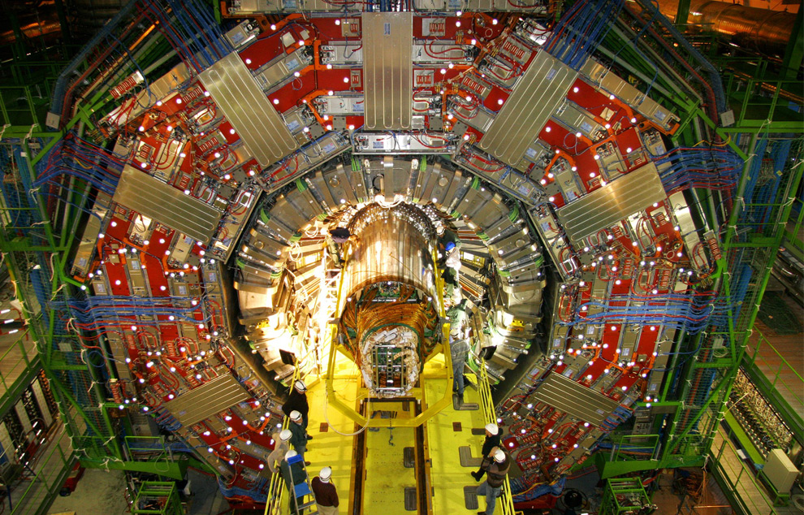
CERN’s Large Hydron Collider (LHC) generates 15 PB a year
Maximilien Brice, © CERN

Slide 7
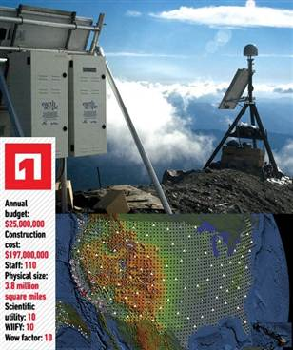
The Earthscope
1.
The Earthscope is the world's largest science project. Designed to track North America's geological evolution, this observatory records data over 3.8 million square miles, amassing 67 terabytes of data. It analyzes seismic slips in the San Andreas fault, and also the plume of magma underneath Yellowstone and much, much more. (http://www.msnbc.msn.com/id/44363598/ns/technology_and_science-future_of_technology/#.TmetOdQ--uI)

Slide 8
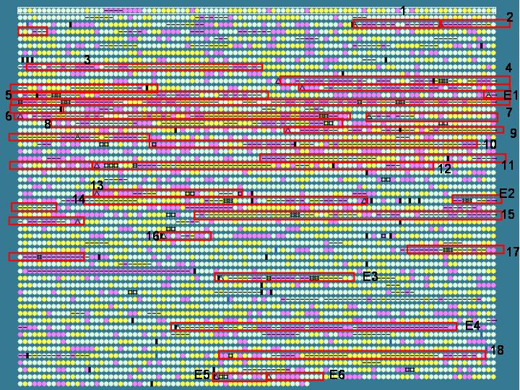
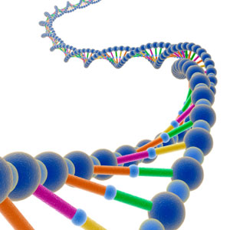
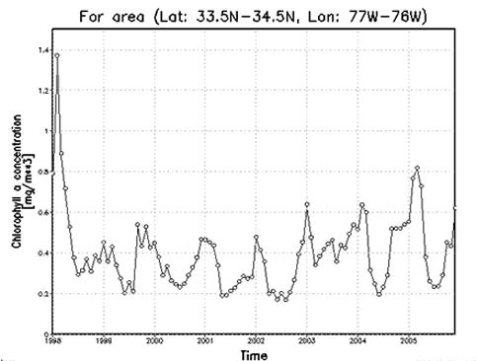
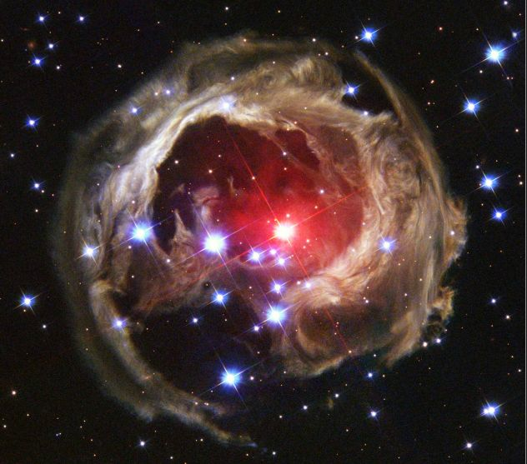
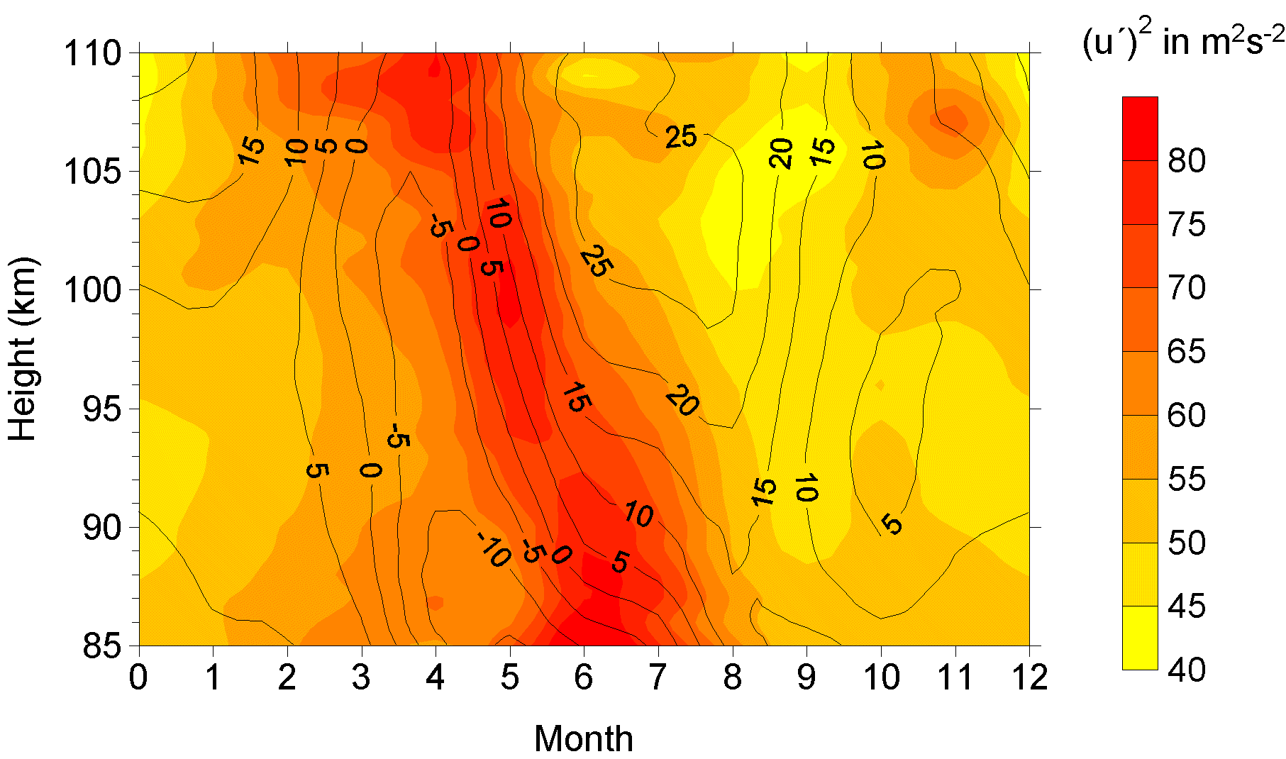

Variety (Complexity)
Relational Data (Tables/Transaction/Legacy Data)
Text Data (Web)
Semi-structured Data (XML)
Graph Data
Social Network, Semantic Web (RDF), …
Streaming Data
You can only scan the data once
A single application can be generating/collecting many types of data
Big Public Data (online, weather, finance, etc)
To extract knowledge➔ all these types of data need to linked together

Slide 9

Velocity (Speed)
Data is begin generated fast and needs to be processed fast
Online Data Analytics
Late decisions ➔ missing opportunities
Examples
E-Promotions: Based on your current location, your purchase history, what you like ➔ send promotions right now for store next to you
Healthcare monitoring: sensors monitoring your activities and body ➔ any abnormal measurements require immediate reaction

Slide 10



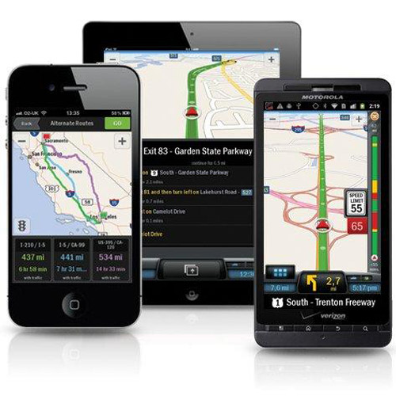
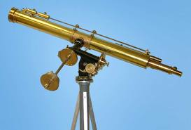
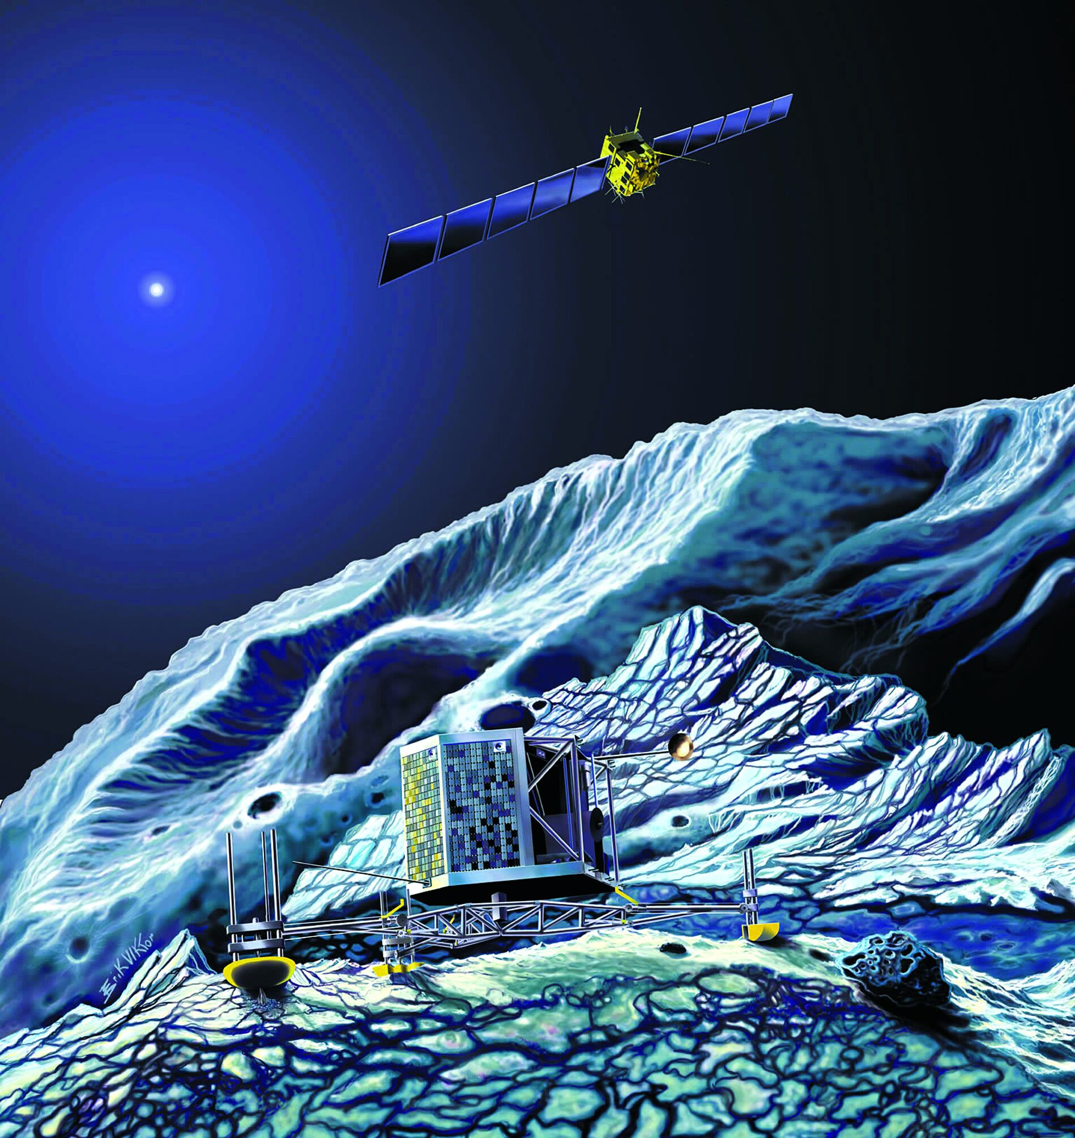
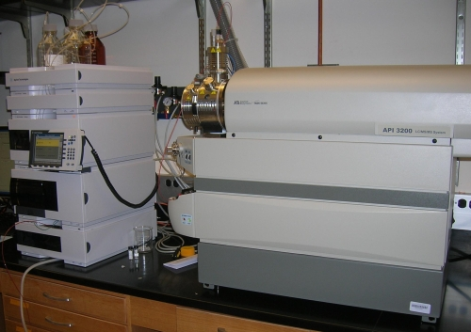
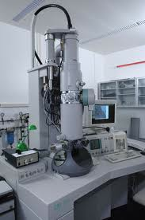
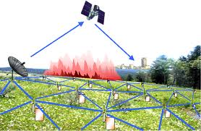

Real-time/Fast Data
Mobile devices
(tracking all objects all the time)
Social media and networks
(all of us are generating data)
Scientific instruments
(collecting all sorts of data)
Sensor technology and networks
(measuring all kinds of data)
Progress and innovation is no longer hindered by the ability to collect data
But, by the ability to manage, analyze, summarize, visualize, and discover knowledge from the collected data in a timely manner and in a scalable fashion

Slide 11
MapReduce
Challenges:
Data doesn’t fit on one machine
How to distribute computation?
Distributed/parallel programming is hard
Issue: Copying data over a network takes time
Idea:
Bring computation close to the data
Store files redundantly for reliability
Map-reduce addresses all of the above
Google’s computational/data manipulation model
Simplified way to work with big data
Relies on the system more than the programmer

Slide 12
Programming Model: MapReduce
Warm-up task:
We have a huge text document
Count the number of times each distinct word appears in the file
Sample application:
Analyze web server logs to find popular URLs

Slide 13
Task: Word Count
Case 1:
File too large for memory, but all <word, count> pairs fit in memory
Just read the file and sum up the <word, count> pairs as you go
Case 2:
Count occurrences of words:
words(doc.txt) | sort | uniq -c
where words takes a file and outputs the words in it, one per a line
Case 2 captures the essence of MapReduce
Great thing is that it is naturally parallelizable

Slide 14
MapReduce: Overview
Sequentially read a lot of data
Map:
Extract something you care about
Group by key: Sort and Shuffle
Reduce:
Aggregate, summarize, filter or transform
Write the result
Outline stays the same, Map and Reduce change to fit the problem

Slide 15
MapReduce: The Map Step
Input
key-value pairs
Intermediate
key-value pairs
k
v
map
k
v
k
v
map
k
v
k
v
…
…
k
v
k
v

Slide 16
MapReduce: The Reduce Step
Output
key-value pairs
Intermediate
key-value pairs
Key-value groups
reduce
k
v
k
v
v
v
k
v
Group
by key
reduce
k
v
k
v
v
k
v
k
v
…
…
…
k
v
k
v
k
v

Slide 17
MapReduce: Word Counting
Provided by the programmer
Provided by the programmer
MAP:
Read input and produces a set of key-value pairs
Group by key:
Collect all pairs with same key
Reduce:
Collect all values belonging to the key and output
The crew of the space shuttle Endeavor recently returned to Earth as ambassadors, harbingers of a new era of space exploration. Scientists at NASA are saying that the recent assembly of the Dextre bot is the first step in a long-term space-based man/mache partnership. '"The work we're doing now -- the robotics we're doing -- is what we're going to need ……………………..
(The, 1)
(crew, 1)
(of, 1)
(the, 1)
(space, 1)
(shuttle, 1)
(Endeavor, 1)
(recently, 1)
….
(crew, 1)
(crew, 1)
(space, 1)
(the, 1)
(the, 1)
(the, 1)
(shuttle, 1)
(recently, 1)
…
(crew, 2)
(space, 1)
(the, 3)
(shuttle, 1)
(recently, 1)
…
Big document
(key, value)
(key, value)
(key, value)

Slide 18
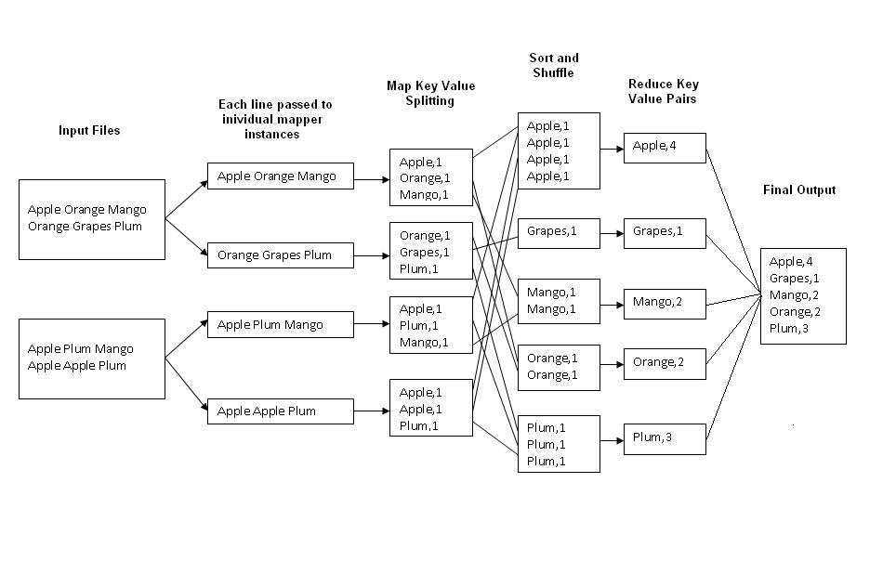
MapReduce: Word Counting
Map
Tasks
Reduce
Tasks

Slide 19
Word Count Using MapReduce
map(key, value):
// key: document name; value: text of the document
for each word w in value:
emit(w, 1)
reduce(key, values):
// key: a word; value: an iterator over counts
result = 0
for each count v in values:
result += v
emit(key, result)

Slide 20
Example 2: Color Count
Job: Count the number of each color in a data set
Input blocks on HDFS
Produces (k, v)
( , 1)
Shuffle & Sorting based on k
Consumes(k, [v])
( , [1,1,1,1,1,1..])
Produces(k’, v’)
( , 100)
Part0001
Part0002
Part0003
That’s the output file, it has 3 parts on probably 3 different machines

Slide 21
Spark Goals
Extend the MapReduce model to better support two common classes of analytics apps:
>> Iterative algorithms (machine learning, graph)
>> Interactive data mining
Enhance programmability:
>> Integrate into Scala programming language
>> Allow interactive use from Scala interpreter
>> Can also use python

Slide 22
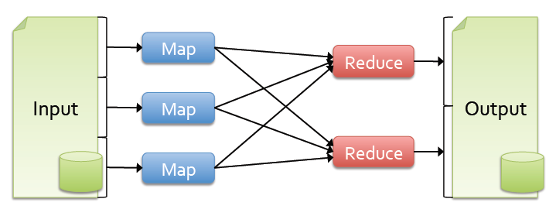
Background
Most current cluster programming models are based on directed acyclic data flow from stable storage to stable storage
Benefits of data flow: runtime can decide where to run tasks and can automatically recover from failures

Slide 23
Problem
Acyclic data flow is inefficient for applications that repeatedly reuse a working set of data:
>> Iterative algorithms (machine learning, graphs)
>> Interactive data mining tools (R, Excel, Python)
With current frameworks, apps reload data from stable storage on each query

Slide 24
Spark Overview
Goal: work with distributed collections as you would with local ones
Concept: resilient distributed datasets (RDDs)
>> Immutable collections of objects spread across a cluster
>> Built through parallel transformations (map, filter, etc)
>> Automatically rebuilt on failure
>> Controllable persistence (e.g. caching in RAM) for reuse
>> Shared variables that can be used in parallel operations

Slide 25

Example: Mining Console Logs
Load error messages from a log into memory, then interactively search for patterns
Base RDD
Cache 1
Transformed RDD
lines = spark.textFile(“hdfs://...”)
errors = lines.filter(lambda s: s.startswith(“ERROR”))
messages = errors.map(lambda s: s.split(‘\t’)[2])
messages.cache()
tasks
Worker
Block 1
results
Driver
Action
messages.filter(lambda s: “foo” in s).count()
Cache 2
messages.filter(lambda s: “bar” in s).count()
Worker
. . .
Cache 3
Worker
Block 2
Result: full-text search of Wikipedia in <1 sec (vs 20 sec for on-disk data)
Result: scaled to 1 TB data in 5-7 sec (vs 170 sec for on-disk data)
Block 3
Notes:
Key idea: add “variables” to the “functions” in functional programming

Slide 26
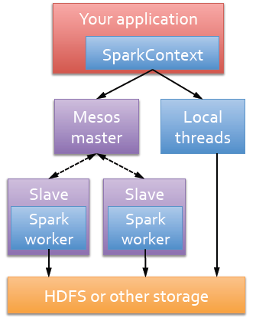
Run Spark
Spark runs as a library in your program
(1 instance per app)
Runs tasks locally or on Mesos
import pyspark
from pyspark.sql import SparkSession
spark = SparkSession.builder.appName(”SparkExample").getOrCreate()
sc = spark.sparkContext

Slide 27
First Stop: SparkContext
Main entry point to Spark functionality
Created for you in Spark shells as variable sc
In standalone programs, you’d make your own
from pyspark.sql import SparkSession
spark = SparkSession.builder.appName("WordCountExample").getOrCreate()
sc = spark.sparkContext
sc.setLogLevel('WARN’)
lines = sc.textFile('bible.txt’)
…

Slide 28
RDD Abstraction
An RDD is a read-only , partitioned collection of records
Can only be created by :
1) Data in stable storage
2) Other RDDs (transformation , lineage)
An RDD has enough information about how it was derived from other datasets(its lineage) to rebuild it
Users can control two aspects of RDDs:
1) Persistence (in RAM, reuse)
2) Partitioning (hash, range, [<k, v>])
Notes:
RDD可以根据关键字指定分区顺序，
目前支持hash分区和range分区。用户可以使用同一种hash来将两个RDD进行分区，这样便于以后的join操作。
RDD是静态类型对象，当然你也可以像定义其他对象一样来定义RDD，如RDD[Int]

Slide 29
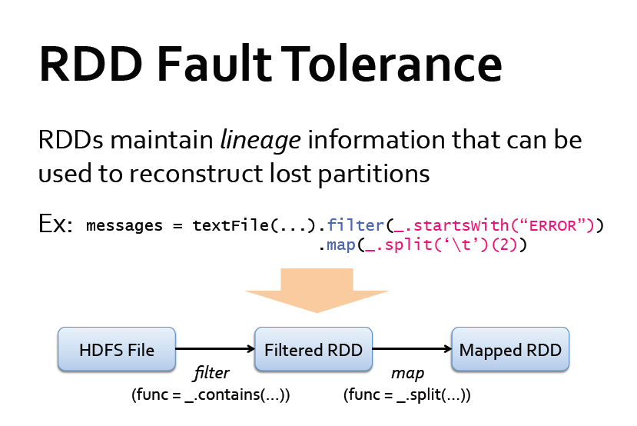
Notes:
尽管RDD中的lineage信息可以用来故障恢复，但对于那些lineage链较长的RDD来说，这种恢复可能很耗时。例如4.3小节中的Pregel任务，每次迭代的顶点状态和消息都跟前一次迭代有关，所以lineage链很长。如果将lineage链存到物理存储中，再定期对RDD执行检查点操作就很有效。
一般来说，lineage链较长、宽依赖的RDD需要采用检查点机制。这种情况下，集群的节点故障可能导致每个父RDD的数据块丢失，因此需要全部重新计算。将窄依赖的RDD数据存到物理存储中可以实现优化，例如前面4.1小节逻辑回归的例子，将数据点和不变的顶点状态存储起来，就不再需要检查点操作。
当前Spark版本提供检查点API，但由用户决定是否需要执行检查点操作。今后我们将实现自动检查点，根据成本效益分析确定RDD 血统关系图（lineage graph）中的最佳检查点位置。

Slide 30
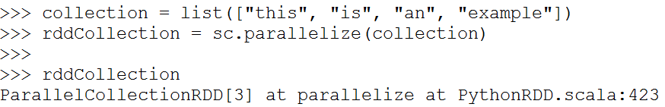
Resilient Distributed Datasets (RDD)
RDD can be created from existing collections
RDD can also be created from an existing file
sc.textFile(“file.txt”)
sc.textFile(“directory/*.txt”)
sc.textFile(“hdfs://namenode:9000/path/file”)

Slide 31
Spark Operations
Once an RDD is created, we have a distributed collection of records that we can manipulate
There are 2 types of operations we can perform
Transformation
Applies the same function to all the records
Lazy evaluation – not evaluated immediately
Action
Runs some computation or aggregation operation and returns the result to the driver program where SparkContext is running
Eager evaluation – evaluated right way

Slide 32
Examples of Spark Transformations
map() – analogous to FOREACH
flatMap() – FOREACH and flatten the result
filter()
sample()
union()
intersection()
distinct()
join()

Slide 33
Examples of Spark Actions
collect() – bring all the results to one node
count()
first()
take() – just grab a few from the top
reduceByKey()
saveAsTextFile()

Slide 34
Transformations
Create a new dataset from an existing one.
Evaluated lazily – won’t be executed until action is called for

Slide 35
Transformations

Slide 36
Transformations

Slide 37
Transformations

Slide 38
Actions
Kick off evaluations and begin computation
Specify the result of an operation or aggregation

Slide 39
Actions

Slide 40
Actions

Slide 41
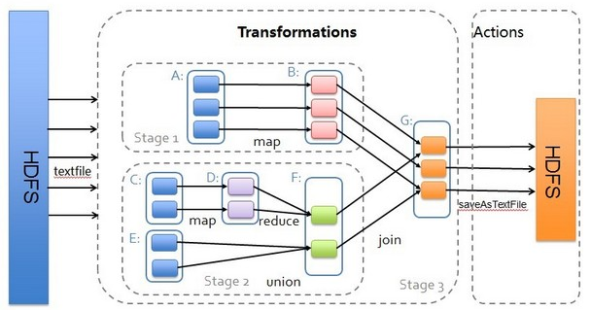
Transformations & Actions

Slide 42
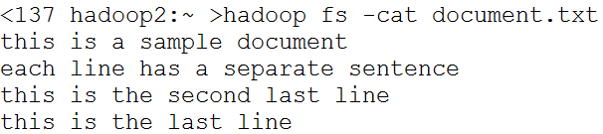
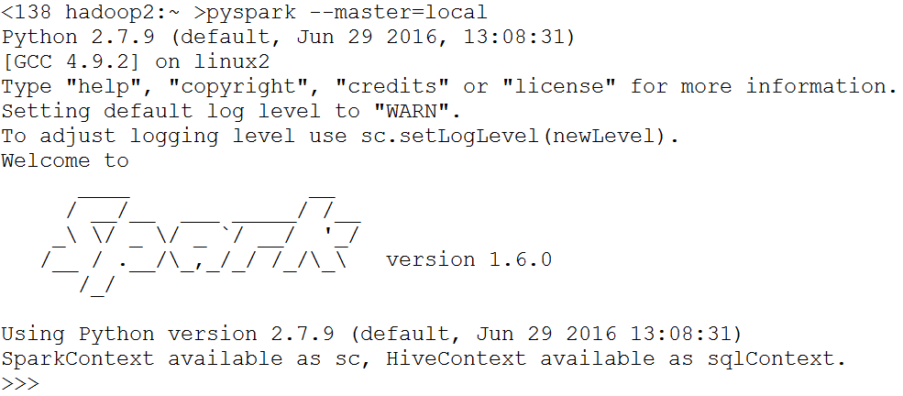
WordCount Example
Sample document data
Run pyspark (in local mode)

Slide 43
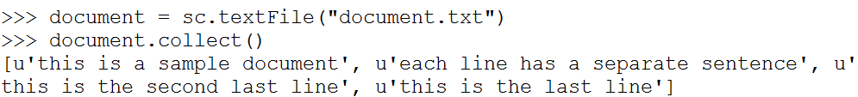
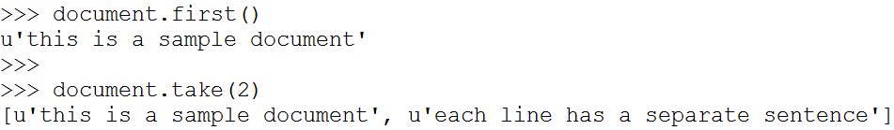
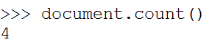
WordCount Example
Load the documents into an RDD and display it
Show the first record and first two records of RDD
Count the number of records in the RDD

Slide 44
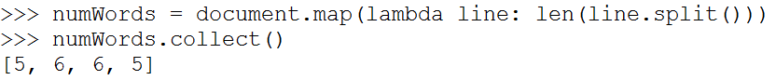
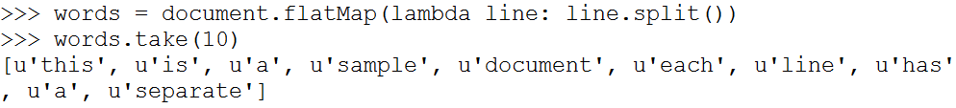
WordCount Example
Tokenize each line and count the number of words
Tokenize each line and flatten it into a list of words

Slide 45
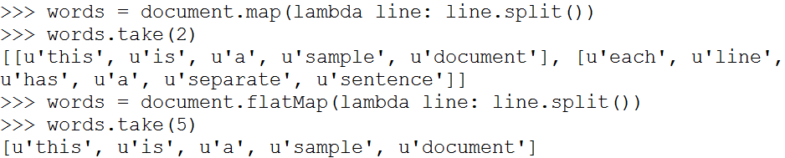
map() and flatMap()
map()
returns a new RDD containing values created by applying function to each value in the original RDD
flatMap():
applies function which takes each input value and returns a list. Each value of the list becomes a new, separate value in the output RDD

Slide 46
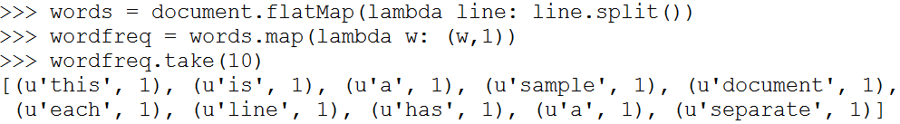
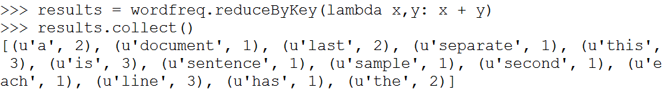
WordCount Example
Tokenize each line, flatten it into a list of words, and emit each word with a frequency of 1
Apply reducer to sum up the word frequencies

Slide 47
reduceByKey()
reduceByKey()
Applies function to its input, which contains a collection of key-value pairs
Creates a new RDD for each key, where the value is obtained by applying the supplied lambda function to the values with matching key in the input RDD

Slide 48
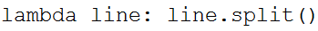
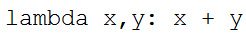
Lambda: Anonymous Functions
Functions that are not bound to any name
Examples:
Function that takes one input argument and applies the split() function to the argument
Function that takes two input arguments and returns the sum of both argument values

Slide 49
WordCount complete code
import sys
from pyspark import SparkContext
spark = SparkSession.builder \
.appName("WordcountExample") \
.getOrCreate()
sc = spark.sparkContext
sc.setLogLevel('WARN’)
lines = sc.textFile('bible.txt’)
counts = lines.flatMap(wordsFromLine) \
.map(lambda x: (x, 1)) \
.reduceByKey(add) \
.sortBy(lambda a: a[1], False) # sort in descending order
output = counts.collect()
for i in range(0,50):
print("%s: %i" % (output[i][0], output[i][1]))

Slide 50
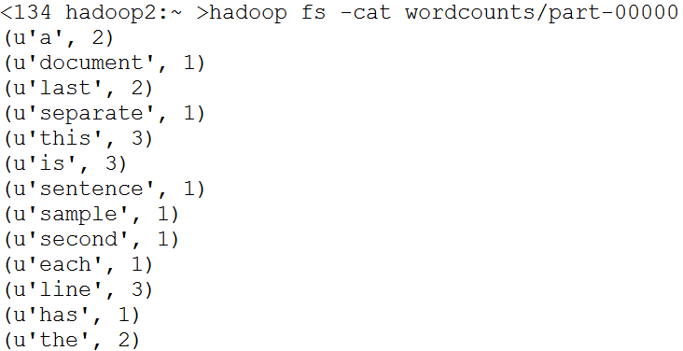
WordCount Example
Store the results in output directory on HDFS
Display the results

Slide 51
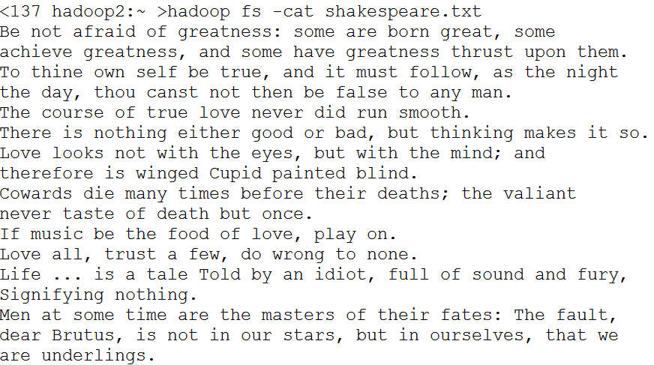
Another Example
Input data: Shakespeare’s quotes

Slide 52
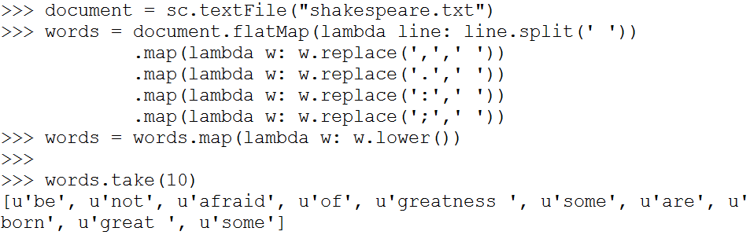
Another WordCount Example
Need to perform more preprocessing:
Remove punctuations (colons, periods, commas, semicolons)
Convert letters to lower-case

Slide 53
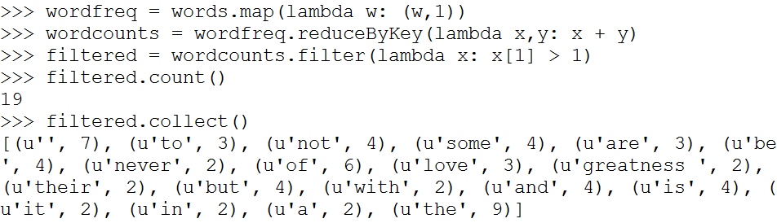
Another WordCount Example
Count the frequency of words and filter out the words that appear only once

Slide 54
Example: PageRank

Slide 55
Why PageRank?
Good example of a more complex algorithm
Multiple stages of map & reduce
Benefits from Spark’s in-memory caching
Multiple iterations over the same data

Slide 56
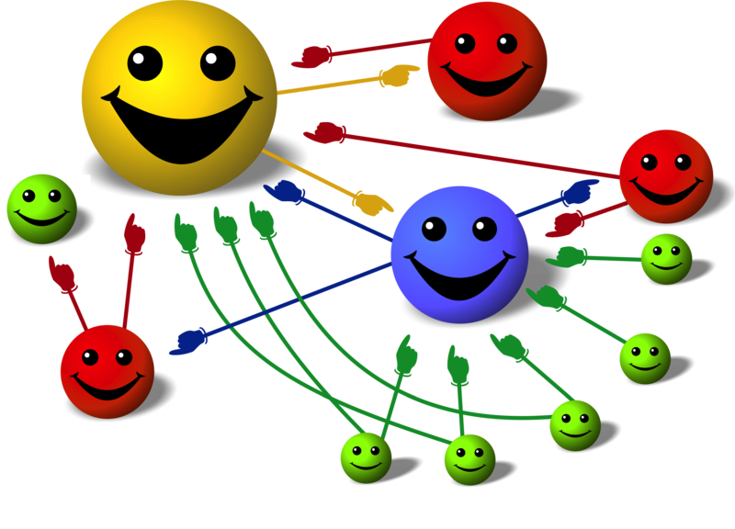
Basic Idea
Give pages ranks (scores) based on links to them
Links from many pages ➔ high rank
Link from a high-rank page ➔ high rank
Image: en.wikipedia.org/wiki/File:PageRank-hi-res-2.png

Slide 57
Algorithm
Start each page at a rank of 1
On each iteration, have page p contribute rank_{p} / |neighbors_{p}| to its neighbors
Set each page’s rank to 0.15 + 0.85 × contribs
1.0
1.0
1.0
1.0

Slide 58
Algorithm
Start each page at a rank of 1
On each iteration, have page p contribute rank_{p} / |neighbors_{p}| to its neighbors
Set each page’s rank to 0.15 + 0.85 × contribs
1.0
1
0.5
1
1.0
0.5
1.0
0.5
0.5
1.0

Slide 59
Algorithm
Start each page at a rank of 1
On each iteration, have page p contribute rank_{p} / |neighbors_{p}| to its neighbors
Set each page’s rank to 0.15 + 0.85 × contribs
1.85
0.58
1.0
0.58

Slide 60
Algorithm
Start each page at a rank of 1
On each iteration, have page p contribute rank_{p} / |neighbors_{p}| to its neighbors
Set each page’s rank to 0.15 + 0.85 × contribs
1.85
0.58
0.5
1.85
0.58
0.29
1.0
0.5
0.29
0.58

Slide 61
Algorithm
Start each page at a rank of 1
On each iteration, have page p contribute rank_{p} / |neighbors_{p}| to its neighbors
Set each page’s rank to 0.15 + 0.85 × contribs
1.31
0.39
. . .
1.72
0.58

Slide 62
Algorithm
Start each page at a rank of 1
On each iteration, have page p contribute rank_{p} / |neighbors_{p}| to its neighbors
Set each page’s rank to 0.15 + 0.85 × contribs
Final state:
1.44
0.46
1.37
0.73

Slide 63
Sample PageRank Iteration (1)
Iteration 1
n₂ (0.2)
n₂ (0.166)
n₁ (0.2)
0.1
0.1
0.1
n₁ (0.066)
0.1
0.066
0.066
0.066
n₅ (0.2)
n₃ (0.2)
n₅ (0.3)
n₃ (0.166)
0.2
0.2
n₄ (0.2)
n₄ (0.3)

Slide 64
Sample PageRank Iteration (2)
Iteration 2
n₂ (0.166)
n₂ (0.133)
n₁ (0.066)
0.033
0.083
0.083
n₁ (0.1)
0.033
0.1
0.1
0.1
n₅ (0.3)
n₃ (0.166)
n₅ (0.383)
n₃ (0.183)
0.3
0.166
n₄ (0.3)
n₄ (0.2)

Slide 65
PageRank in MapReduce
n₁ [n₂, n₄]
n₂ [n₃, n₅]
n₃ [n₄]
n₄ [n₅]
n₅ [n₁, n₂, n₃]
Map
n₂
n₄
n₃
n₅
n₄
n₅
n₁
n₂
n₃
n₁
n₂
n₂
n₃
n₃
n₄
n₄
n₅
n₅
Reduce
n₁ [n₂, n₄]
n₂ [n₃, n₅]
n₃ [n₄]
n₄ [n₅]
n₅ [n₁, n₂, n₃]

Slide 66
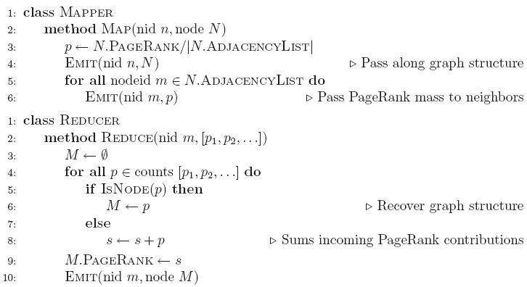
PageRank MapReduce Pseudo-Code

Slide 67
Pyspark Implementation
links = # RDD of (url, neighbor) pairs
ranks = # RDD of (url, rank) pairs
for i in range(NUM_ITERATIONS):
def compute_contribs(pair): [url, [links, rank]] = pair # split key-value pair
return [(dest, rank/len(links)) for dest in links]
contribs = links.join(ranks).flatMap(compute_contribs)
ranks = contribs.reduceByKey(lambda x, y: x + y) \ .mapValues(lambda x: 0.15 + 0.85 * x) ranks.saveAsTextFile(...)

Slide 68
PageRank Performance
Notes:
54 GB Wikipedia dataset

Slide 69
Other Iterative Algorithms
Time per Iteration (s)
Notes:
100 GB datasets

Slide 70
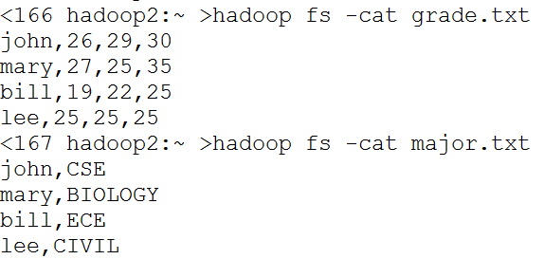
Example: Grade data
Input data
Schema:
grade( name, hw1, hw2, hw3 )
major( name, dept )

Slide 71
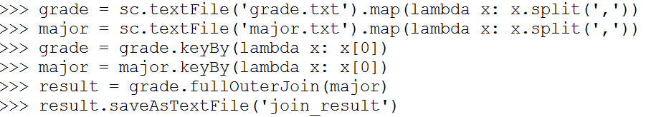
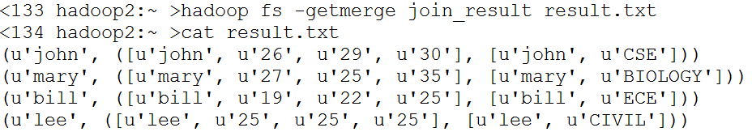
Example: Grade data
Create a joined RDD from RDDs for grade and major
Use rdd.keyBy() to specify the keys for joining
We still need to process the result to merge the tuples → PAINFUL

Slide 72
DataFrames in Spark
Distributed collection of data grouped into named columns (i.e. RDD with schema)
Domain-specific functions designed for common tasks
Metadata
Sampling
Project, filter, aggregation, join, …
User Defined Functions
Available in Python, Scala, Java, and R
Analogous to pandas DataFrame
Useful commands
rdd.toDF(schema): convert rdd to DataFrame with specified schema
df.join(df2, condition, type): join two data frames
df.filter( expression ): apply filter to the rows
df.groupBy( group ): apply group by operator
df.agg([col: func]) : apply aggregation function on columns

Slide 73
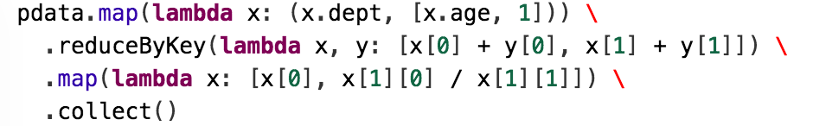
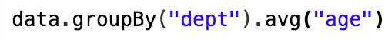

Slide 74
Spark DataFrame
Similar APIs as single-node tools like Pandas, R, i.e., easy to learn
> head(filter(df, df$waiting < 50)) # an example in R
## eruptions waiting
##1 1.750 47
##2 1.750 47
##3 1.867 48
result = gradeDF.join(majorDF, gradeDF['name'] == majorDF['name'], how='inner')
*Old Faithful geyser data from http://www.stat.cmu.edu/~larry/all-of-statistics/=data/faithful.dat

Slide 75
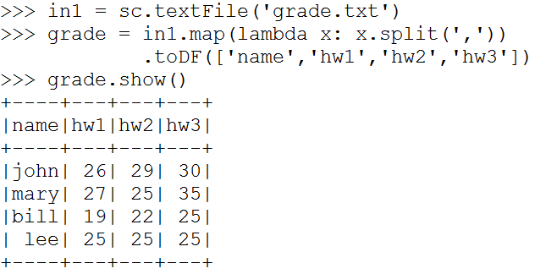
Example: Grade data
Load the grade file into a pySpark dataframe
## Better way to load data into a dataframe
gradeDF = spark.read.option("header", "true").csv("grades.csv")

Slide 76
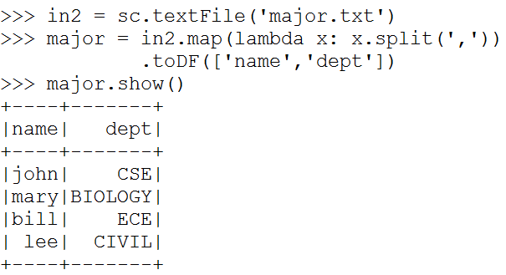
Example: Grade data
Load the major file into a pySpark data frame
## Better way to load data into a dataframe
majorDF = spark.read.option("header","true").csv("major.csv")

Slide 77
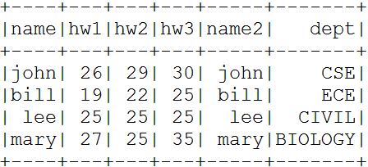

Example: Grade data
Join two pySpark data frames

Slide 78

Example: Grade data
Display schema of a data frame

Slide 79

Example: Grade data
Calculate total grade

Slide 80

Example: Grade data
Find the students whose total grade is greater than 80

Slide 81

Example: Grade data
Create Dataframe for college information

Slide 82

Example: Grade data
Count the number of departments in each college

Slide 83


Example: Grade data
Compute average grade of students in each college

Slide 84
Example: Grade Data
We can do this all with SQL inside Spark too
# First, register the table for SQL so it will be recognized in the SQL statement
studentsDF.registerTempTable("studentsDF")
res = spark.sql("""
select collegename, AVG(hwgrade) from studentsDF
group by studentsDF.collegename
order by 2
""")
res.show()
+-----------+-----------------+
|collegename| avg(hwgrade) |
+-----------+-----------------+
| EGR |75.33333333333333|
| NATSCI | 87.0 |
+-----------+-----------------+

Slide 85
Spark RDD Execution
Java/Scala
frontend
opaque closures
(user-defined functions)
Python
frontend
JVM
backend
Python
backend

Slide 86
Spark DataFrame Execution
DataFrame
frontend
Logical Plan
Intermediate representation for computation
Catalyst
optimizer
Physical execution

Slide 87
Spark DataFrame Execution
Python
DF
Java/Scala
DF
R
DF
Simple wrappers to create logical plan
Logical Plan
Intermediate representation for computation
Catalyst
optimizer
Physical
execution

Slide 88
Performance
RDD

Slide 89
Benefit of Logical Plan: Performance Parity Across Languages
DataFrame
RDD

Slide 90
Further Optimizations
Spark 1.6
14M
rows/s
Whole-stage code generation
Remove expensive iterator calls
Fuse across multiple operators
Spark 2.0
125M
rows/s
Optimized input / output
Parquet + built-in cache
Parquet in 1.6
11M
rows/s
Parquet in 2.0
90M
rows/s
Automatically applies to SQL, DataFrames, Datasets

